Slide 1
www.humicchina.com
Shandong Jingfeng Humic Acid Technology Company Limited
HUMIC & FULVIC ACID

Slide 2
About Jingfeng
WE WITNESS CROP HARVEST AND HUMAN HEALTH
JINGFENG focus on green agriculture , human health . We are committed to humic acid products development , producing and selling. We have achieved remarkable results on development and application of the agriculture humic acid series , feed farming humic acid series , pharmaceutical grade humic acid.
We have a professional analytical laboratory that can conduct comprehensive analysis of different humic acid series products, and can provide a complete set of extraction plans for different humic acid raw materials.
Regarding the application of humic acid in agriculture, we can analyze the soil quality, water quality and crop conditions in different regions, and then formulate fertilizers according to individual cases.
We can make specific fertilization plans for crops planted in concentrated areas, and carry out three-in-one fertilization operations from base fertilizer, flush-release fertilizer, and foliar fertilizer.
At the same time, we can come up with very effective plans for improving soil, such as saline-alkali soil, heavy metal-contaminated soil, and windbreak and sand fixation.
For the application of humic acid in animal feed and aquaculture, we have formulated feed-grade sodium humate, and are also developing a series of formulas that can be used for each animal.
We have also made a series of new progress in industrial applications. At the same time, our R&D team has made new progress in new fields of humic acid, such as food, medicine and other industries, and developed some medical humic acid products with good therapeutic effects.
We are also actively communicating with well-known humic acid experts at home and abroad, and have achieved a series of fruitful research.
www.humicchina.com

Slide 3
Location
WE WITNESS CROP HARVEST AND HUMAN HEALTH
MKT Dept:
A1-1001, Taida Xintiandi, Nanhai Road, Binhai New District, Tianjin，China
CONTACT
Seaweek Production base:
Poji Industrial Park, Puji Town, Jiaozhou City, Qingdao
Humic Acid Production Base #1
Sun'nan'Zhuang village,Yong'an Town, Fenxi County, Linfen City,Shanxi Province, 041000
Humic Acid Production Base #2
Qingshuihe Industri Park, Hohhot, Inner Mongolia
www.humicchina.com

Slide 4
Series Products
WE WITNESS CROP HARVEST AND HUMAN HEALTH
Fulvate+NPK+TE
Fulvic acid
Amino acid chelate fertilizer
Humate+NPK+TE
Fulvate
Animal source amino acid
Plant source amino acid
Pharmaceutical
humic fulvic acid
Humate
Seaweed
extract
Humic acid
Leonardite
Lignite
Peat
New fertilizers
www.humicchina.com

Slide 5
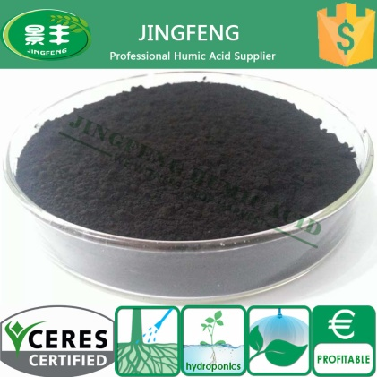
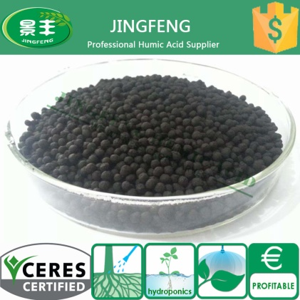
Humic Acid Powder / Granule
WE WITNESS CROP HARVEST AND HUMAN HEALTH
Humic Acid Powder / Granule
Product Code | Appearance | Humic Acid | Fineness | Grain Size
JFHA-HA-1-P/G | Black Powder/Granule | 60% min | 100-120 mesh | 2-4 mm
JFHA-HA-2-P/G | Black Powder/Granule | 50% min | 100-120 mesh | 2-4 mm
JFHA-HA-3-P/G | Black Powder/Granule | 40% min | 100-120 mesh | 2-4 mm
Characteristic
1. | Largely promote the buffering power and fertility of soil by improving the structure and increasing its organic matter.
2. | Neutralize both acidic and alkaline to make it into a optimized soil environment with pH 5.5-7.0.
3. | Foster proper environment for soil microbial mass.
Dosage
1. | Base fertilizer : For field crop, 50-100kgs/ha per crop season.
2. | For fruit trees, 10-kgs per plant. For vegetables, 1-2kg/m2.
3. | Mix additive: 30-60kgs per ton of composite.(suggested mix use with Urea and MAP DAP)
www.humicchina.com
Notes:
Humic Acid Powder / Granule

Slide 6
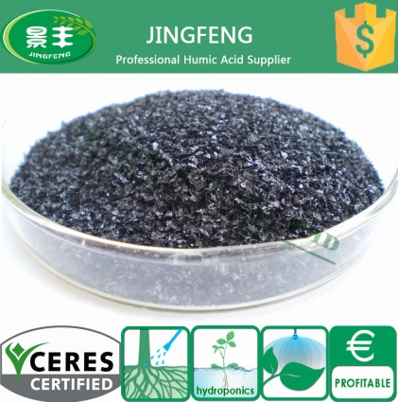
Potassium Humate Flake / Powder
WE WITNESS CROP HARVEST AND HUMAN HEALTH
Potassium Humate Flake / Powder
Product Code | Appearance | Humic Acid | K2O | Water Solubility | Fineness | Flake Size
JFHA-KHA-1-F/P | Black Flake/Powder | 70% min | 10-12% min | 100% | 100-120 mesh | 2-4 mm
JFHA-KHA-2-F/P | Black Flake/Powder | 60-65% min | 10-12% min | 100% min | 100-120 mesh | 2-4 mm
JFHA-KHA-3-P | Black Powder | 50% min | 10-12% min | 80-90% | 100-120 mesh | /
Characteristic
Dosage
1. | Largely promote the buffering power and fertility of soil by improving the structure and increasing its organic matter.
2. | Neutralize both acidic and alkaline to make it into a optimized soil environment with pH 5.5-7.0.
3. | Foster proper environment for soil microbial mass.
4. | Working as natural seed germination and room stimulant. Promote germination of seeds and growth of root system.
5. | Largely optimized the absorption of beneficial ion by plants thus increase plants growth accordingly increase the yield and fruits quality.
6. | Enhance plant‘s ability to counter stressed conditions.
1. | Act as the humic acid raw materials for the production of humic acid fertilizer, the proposed dosage is 5-10%.
2. | Base fertilizer: Used for root fertilization, 10-20kgs per 666㎡, supply potassium element, plenty of organic matter to soil, help to improve soil condition. Can improve drought resistance ability, cold resistance, disease and insect resistance.
3. | Foliar Spray: Used as leaf spray fertilizer, dissolve 30-50 grams into 15-30kgs water, solution concentration is 1:500 to 1:1000. Generally apply fertilizer during seedling stage, growth period, flowering phase and fruiting period, total 4-5 times.
4. | Drop irrigation, water flush: 5-10kgs per time per 666㎡. Dissolve evenly into fertilizer bucket or wash directly with water. Generally apply fertilizer during seedling stage, growth period, flowering phase and fruiting period, total 4-5 times.
5. | Soaking seed, soaking root: Dissolve into water to make 1:2000 concentration solution. Soak 10-24 hours.
www.humicchina.com

Slide 7
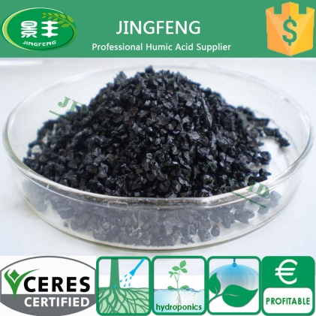
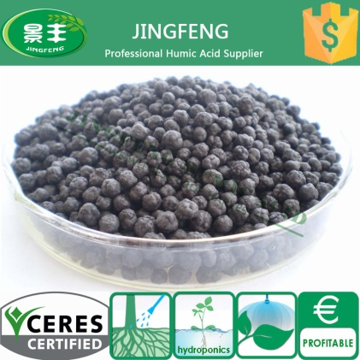
Potassium Humate Crystal / Granule
WE WITNESS CROP HARVEST AND HUMAN HEALTH
Potassium Humate Crystal / Granule
Product Code | Appearance | Humic Acid | K2O | Water Solubility | Moisture | Grain Size
JFHA-KHA-2-C | Black Crystal | 60-65% min | 10-12% min | 95% min | 13% max | 0.5-2mm / 2-5 mm
JFHA-KHA-3-G | Black Granule | 30% min | 3% min | 60% min | 25% max | 2-2 mm
Characteristic
Dosage
1. | Largely promote the buffering power and fertility of soil by improving the structure and increasing its organic matter.
2. | Neutralize both acidic and alkaline to make it into a optimized soil environment with pH 5.5-7.0.
3. | Foster proper environment for soil microbial mass.
4. | Working as natural seed germination and room stimulant. Promote germination of seeds and growth of root system.
5. | Largely optimized the absorption of beneficial ion by plants thus increase plants growth accordingly increase the yield and fruits quality.
6. | Enhance plant‘s ability to counter stressed conditions.
1. | Act as the humic acid raw materials for the production of humic acid fertilizer, the proposed dosage is 5-10%.
2. | Base fertilizer: Used for root fertilization, 10-20kgs per 666㎡, supply potassium element, plenty of organic matter to soil, help to improve soil condition. Can improve drought resistance ability, cold resistance, disease and insect resistance.
3. | Foliar Spray: Used as leaf spray fertilizer, dissolve 30-50 grams into 15-30kgs water, solution concentration is 1:500 to 1:1000. Generally apply fertilizer during seedling stage, growth period, flowering phase and fruiting period, total 4-5 times.
4. | Drop irrigation, water flush: 5-10kgs per time per 666㎡. Dissolve evenly into fertilizer bucket or wash directly with water. Generally apply fertilizer during seedling stage, growth period, flowering phase and fruiting period, total 4-5 times.
5. | Soaking seed, soaking root: Dissolve into water to make 1:2000 concentration solution. Soak 10-24 hours.
www.humicchina.com

Slide 8
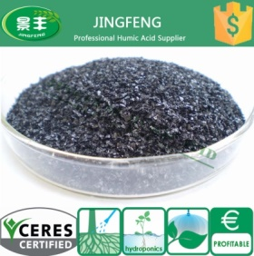
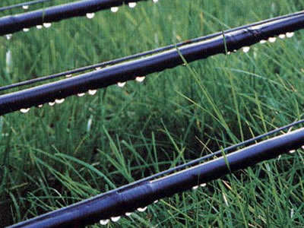
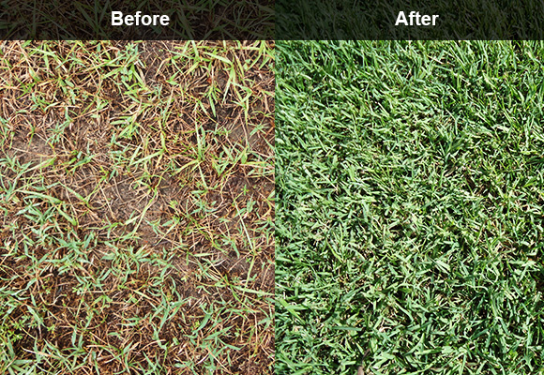
Potassium Fulvate Flake / Powder
WE WITNESS CROP HARVEST AND HUMAN HEALTH
Potassium Fulvate Flake / Powder
Product Code | Appearance | Humic Acid | Fulvic Acid | K2O | Water Solubility | Fineness | Flakes Size
JFHA-KFA-1-F/P | Black Flake/Powder | 65% min | 30% min | 10-12% min | 100% | 100-120 mesh | 2-4 mm
JFHA-KFA-2-F/P | Black Flake/Powder | 65% min | 15% min | 10-12% min | 100% | 100-120 mesh | 2-4 mm
Characteristic
Dosage
1. | Potassium fulvate has higher fulvic acid content thus has good water solubility and good ability to counter flocculation, can be used for foliar spay and drip irrigation, also could mixed with other kinds of fertilizer and pesticide.
2. | Greatly increase the soil fertility ,especial mixed with Urea ,DAP, MAP, MKP. With faster and obvious effect.
3. | Increase the organic matter of soil and improve soil structure, accordingly largely promote the buffering power of soil.
4. | Regulate PH of soil and increase soil fertility.
5. | Create good living environment for microbial mass .
6. | Promote the development of chlorophyll, sugars and amino acids in plants and aid in photosynthesis.
7. | Promote seed germination in short time, Greatly increase harvest and fruits quality.
8. | Greatly increase plants capability counter stress and disease.
Nitrogen | 50-100 grams / hectare for each unit of Nitrogen applied as UAN, Urea, SOA 2.3-4.6 kg/ha with 100 kg/ha of Urea 2.1-4.2 kg/ha with 100 litres of UAN 1.0-2.1 kg/ha with 100 kg/ha of SOA
Salt-water | 5kg/ha with each and all irrigation applications
Salt-Soil Mitigation | 5kg/ha with each and all irrigation applications
Soil Improvement | 5kg/ha with each and all irrigation applications
N.B. | This product is not compatible used in concentration with solution pH under 4. For combination with elements or chemicals solution which pH is under 4, select fulvic acid.
www.humicchina.com

Slide 9
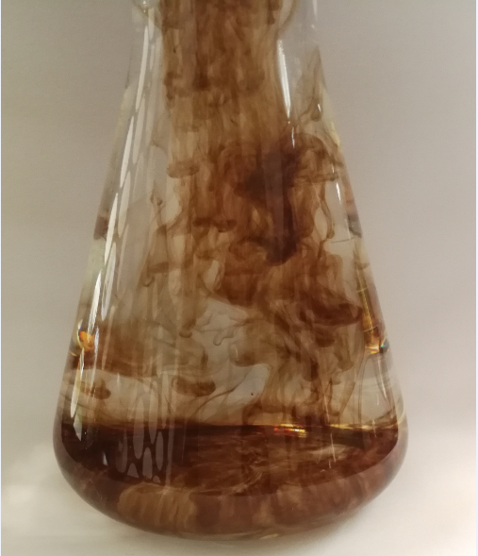
Fulvic Acid Flake / Powder
WE WITNESS CROP HARVEST AND HUMAN HEALTH
Fulvic Acid Flake / Powder
Product Code | Appearance | Fulvic Acid | K2O | Water Solubility | Fineness | Particle Size
JFHA-FA-F/P | Black Flake/Powder | 50% min | 12% min | 100% | 100-120 mesh | 2-4 mm
Dosage
1. | Act as the humic acid raw materials for the production of humic acid fertilizer, the proposed dosage is 5-10%.
2. | Base fertilizer: Used for root fertilization, 10-20kgs per 666㎡, supply potassium element, plenty of organic matter to soil, help to improve soil condition. Can improve drought resistance ability, cold resistance, disease and insect resistance.
3. | Foliar Spray: Used as leaf spray fertilizer, dissolve 30-50 grams into 15-30kgs water, solution concentration is 1:500 to 1:1000. Generally apply fertilizer during seedling stage, growth period, flowering phase and fruiting period, total 4-5 times.
4. | Drop irrigation, water flush: 5-10kgs per time per 666㎡. Dissolve evenly into fertilizer bucket or wash directly with water. Generally apply fertilizer during seedling stage, growth period, flowering phase and fruiting period, total 4-5 times.
5. | Soaking seed, soaking root: Dissolve into water to make 1:2000 concentration solution. Soak 10-24 hours.
Characteristic
1. | 100% water solubility with no flocculation left
2. | Improve soil structure and utilization of potash
3. | Increase the release of potassium
4. | Increase the crop resistance of drought and disease
5. | Improve water storage capacity of soil
6. | Quick release organic fertilizer
7. | Enhance the usability of soil
8. | Stimulate crop growth, control the release of nutrients
9. | Improve the quality and yield of crops, promote the efficiency of fertilizer
www.humicchina.com

Slide 10
Sodium Humate Flake / Powder
WE WITNESS CROP HARVEST AND HUMAN HEALTH
Sodium Humate Flake / Powder
Product Code | Appearance | Humic Acid | Water Solubility | Fineness | Particle Size
JFHA-NaHA-1-F/P | Black Flake/Powder | 70% min | 100% | 100-120 mesh | 2-4 mm
JFHA-NaHA-2-C/P | Black Flake/Powder | 60-65% min | 95% min | 100-120 mesh | 2-4 mm
JFHA-NaHA-3-P | Black Powder | 50% min | 90% min | 100-120 mesh | /
Characteristic
Dosage
Feed additive | Sodium humate forms a kind of protecting film on the mucosa cells of the intestine. Reduces the absorption of toxic substances. Absorb toxins from proteins, toxic residues and various heavy metals. Promote growth and stimulate the immune system.
Aquaculture | Improve the carbon source of water Purification of water quality Physical shade Growing grass Chelating heavy metal ions Improve the substrate, detoxification deodorant
Industry uses | removing toxic metals and their ions from wastewater. Sodium humate can be applied as an adjunct in dissolved air flotation cells to assist in the removal of trace amounts of grease, oil, liquid organics and suspended matter. used as potential fluid loss additives in certain types of organic liquids to prevent seepage from lagoons or pit containment areas.
 | Fertigation and Foliar
Additive. | Feed ingredients, drinking water, mineral supplements
Additive amount(Sodium humate shiny flake / powder) | 2‰-3‰per MT fodder
Drinking water(Sodium humate shiny flake, sodium humate crystal) | 1 gram per litre of water
Unhealthy Animals(Sodium humate shiny flake, sodium humate crystal) | Initial support: 20 gram per 100kg of body weight Subsequent: 5gram per 100kg of body weight
www.humicchina.com

Slide 11
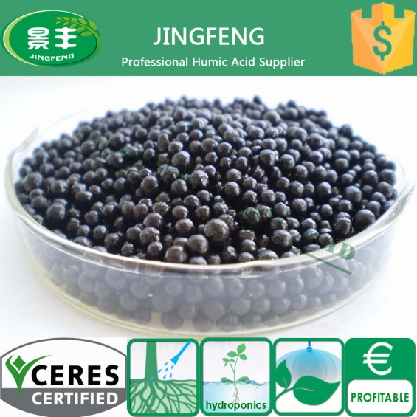
Humic Amino Granule
WE WITNESS CROP HARVEST AND HUMAN HEALTH
Humic Amino Granule
Product Code | Appearance | Amino Acid | Humic Acid | Moisture | Organic Mater | Amino nitrogen | Grain Size
JFHA-AA-1-G | Black Shiny Granule | 5% min | 10% min | 1% max | 25% min | 16% min | 2-4 mm
JFHA-AA-2-G | Black Shiny Granule | 10% min | 15% min | 1% max | 45% min | 12% min | 2-4 mm
Characteristic
1. | Provide plants with necessary amino acid and peptides also largely save the energy for their synthesis.
2. | Enhanced capability to counter stress condition ( drought, hot or cold temperature, transplanting stress etc.) and disease.
3. | Soluble humate will help to slow release nitrogen and release locked-up phosphorus also activate the micro element in the oil to increase fertility.
Dosage
1. | Base fertilizer : For field crop, 50-100kgs/ha per crop season.
2. | For fruit trees, 10-kgs per plant. For vegetables, 1-2kg/m2.
3. | Mix additive: 30-60kgs per ton of composite.(suggested mix use with Urea and MAP DAP)
www.humicchina.com

Slide 12
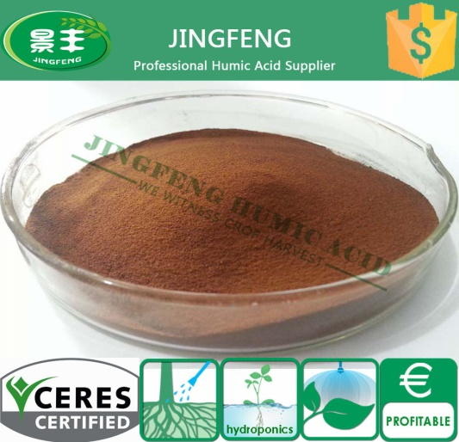
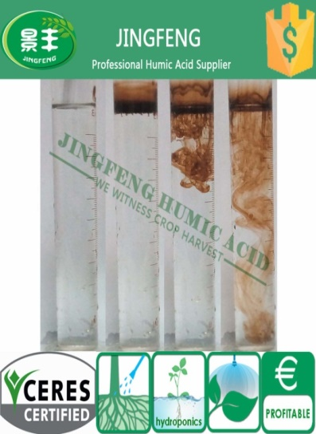
Bio Fulvic Acid Powder / Bio Potassium Fulvate Powder
WE WITNESS CROP HARVEST AND HUMAN HEALTH
Bio Fulvic Acid Powder / Granule
Product Code | Appearance | Bio Fulvic Acid | K2O | Moisture | Organic Mater | Water Solubility | Partical Size
JFHA-BFA-P | Brown Powder | 60% min | 12% min | 1% max | 60% min | 100% | 80-100 mesh
JFHA-BFA-G | Brown Irregular Granule | 20% min | 5% min | 5% max | / | 100% | 2-4 mm
JAHA-BAF-G | Brown Round Granule | 50% min | 10% min | 1% max | 50% min | 100% | 2-3 mm
Characteristic
1. | Improve soil structure, decrease soil moisture consuming and balance ph value of soil.
2. | Improve the effectiveness of pesticides and fertilizer.
3. | Increase water holding capability by shrinking the stoma and provide drought protection.
4. | Strengthen root system and improve seed germination.
5. | Good supplement of calcium and sulfur to the foliar of plants.
6. | Improve the form of enzyme of plants and quality of plants.
7. | Convert and chelate trace elements and improve nutrients uptake by plants.
8. | Stimulate growth and increase yield.
9. | Increase anti-disease capability of plants.
10. | Provide overall nutrient and physiologic adjustment to plants and obtain healthy growth.
Dosage
Base fertilizer : For field crop, 50-100kgs/ha per crop season.
For fruit trees, 10-kgs per plant. For vegetables, 1-2kg/m2.
Mix additive: 30-60kgs per ton of composite.(suggested mix use with Urea and MAP DAP)
www.humicchina.com

Slide 13
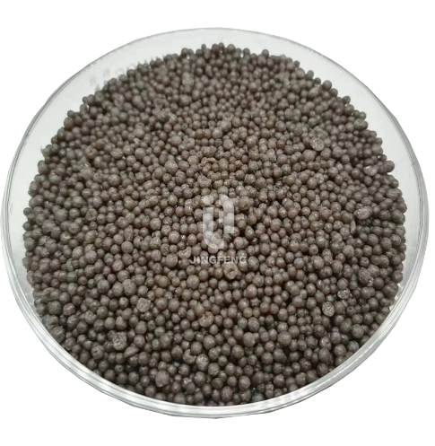
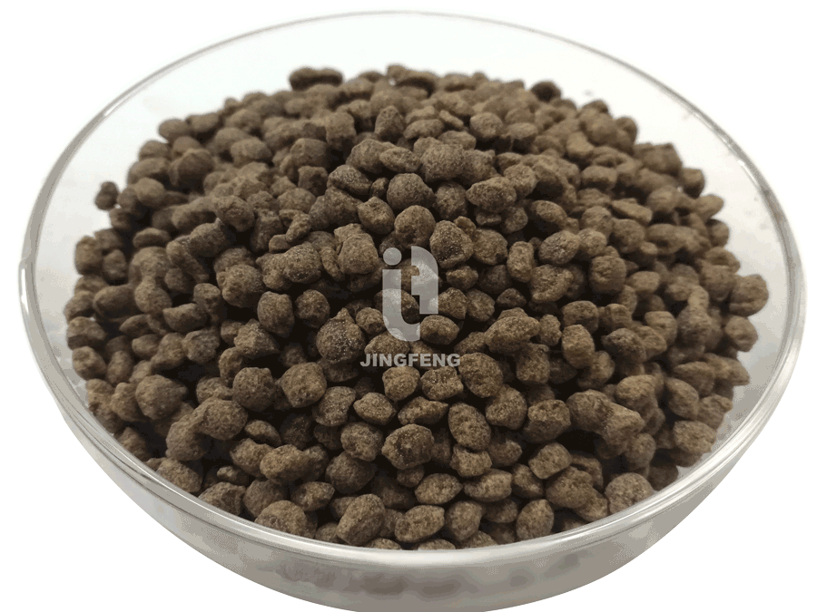
Bio Fulvic Acid Granule
WE WITNESS CROP HARVEST AND HUMAN HEALTH
Bio Fulvic Acid Granule
Product Code | Appearance | Bio Fulvic Acid | K2O | Moisture | Organic Mater | Water Solubility | Partical Size
JAHA-BAF-G | Brown Round Granule | 50% min | 10% min | 5% max | 30% min | 100% | 2-3 mm
JFHA-BFA-G | Brown Irregular Granule | 20% min | 5% min(OEM) | 5% max | / | 100% | 2-4 mm
Characteristic
Dosage
1. | Kinds of nutrition and timely supply.it is rich in Organic matter ,amino acids, proteins, nucleic acids, betaine and bio-fulvic acid, while it contains inorganic (N+P2O5+K2O) nutrients and calcium, magnesium, sulfur, iron, zinc, manganese, copper, molybdenum, boron and other trace elements, which satisfy the requirements of crops. Nutritional balance improve crop growth, buds fatness, roots strength, seeding vigorous, well leaf photosynthesis, lodging-resistance, high fruit set rate, and make the crops early bring forward market and extend the harvest picking.
2. | Improvement of nutrients balance in the soil. Application of fertilizers can promote the formation of aggregate structure and improve the capacity of soil permeability, water, fertilizer and drainage by the gelation, adsorption and mineralization, and coordinate the four factors of supplement of water, fertilizer, gas and heat in the arable land, so that to achieve sustainable use of soil.
3. | Complement organic matter, activate available Microorganisms. Beneficial bacteria break down the fixed NPK nutrients in soil, reduce losses and improve fertilizer efficiency, and inhibit the spread of harmful micro-organisms development, active plant activity, and improve crop resistance, anti-cropping and so on.
1.Irrigation/spaying: Dilute the fertilizer with 500-800 times water before irrigation/spraying. Apply 200-400kg/ha.
2.Drop-irrigation: Dilute the fertilizer with 800-1000 times water before irrigation. Irrigate 3-5 times. Apply 200-400kg/ha.
As base fertilizer, apply 300-600kg/ha with appropriate amount compound fertilizer 5-7 days before crops transplanting or 5-7 days after harvest. Apply with mineral fertilizer for better effect.
www.humicchina.com

Slide 14
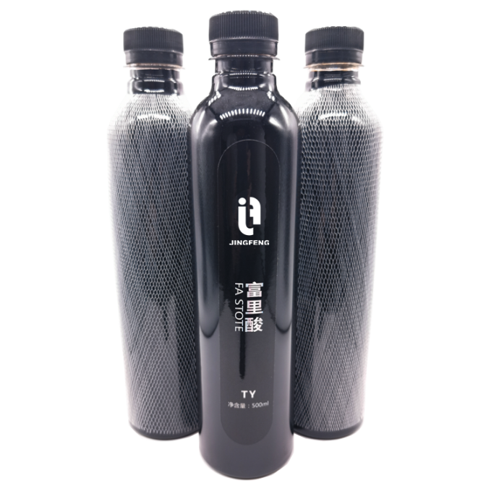
Medical Grade Fulvic Acid
WE WITNESS CROP HARVEST AND HUMAN HEALTH
Meidical Grade Fulvic Acid
Product Code | Fulvic Acid | Water Solubility
JFHA-MFA | 99.75% min | 100%
Characteristic
Blood Properties | The red blood cells have the capability of carrying higher percentages of oxygen when in the presence of humate. Human subjects taking humate have reported feelings of euphoria, similar to hyperventilating, during the first few days of taking humate. This euphoria is a result of additional oxygen. Healing of injuries, as a result of additional oxygen, is much quicker.
Helpful for Mineral Transfer | Humates contain both humic and fulvic acids. The fulvic acid is the chelator that carries the minerals. Help to increase the absorption of calcium and transfer iodine from foods into the thyroid glands.Most importantly ,fulvic acid captures and removes toxic metals from the body.
Cell Mutation | Humic acid also significantly accelerated the healing process of experimentally induced ulcers Anti-inflammatory & Anti-Viral Properties
Liver effect | A large part of the humate takes an active part in the liver metabolism. The use of humate plays a role in the liver function and protects it somewhat from disease and/or disturbances. Pharmaceutical Humic Acid Technical Data Sheet.
www.humicchina.com

Slide 15
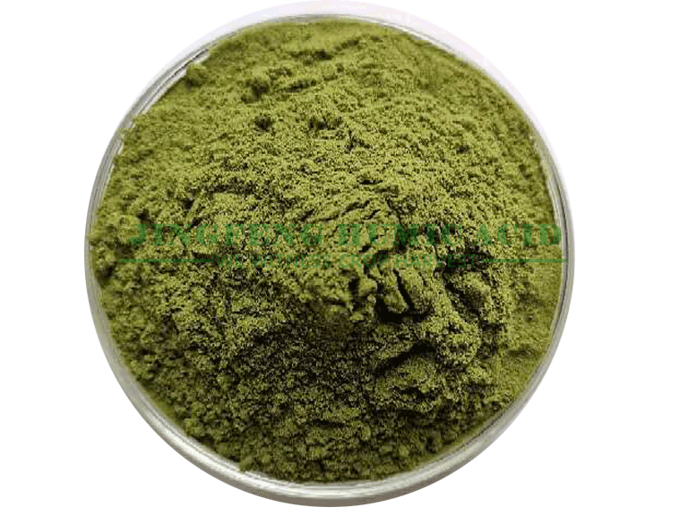
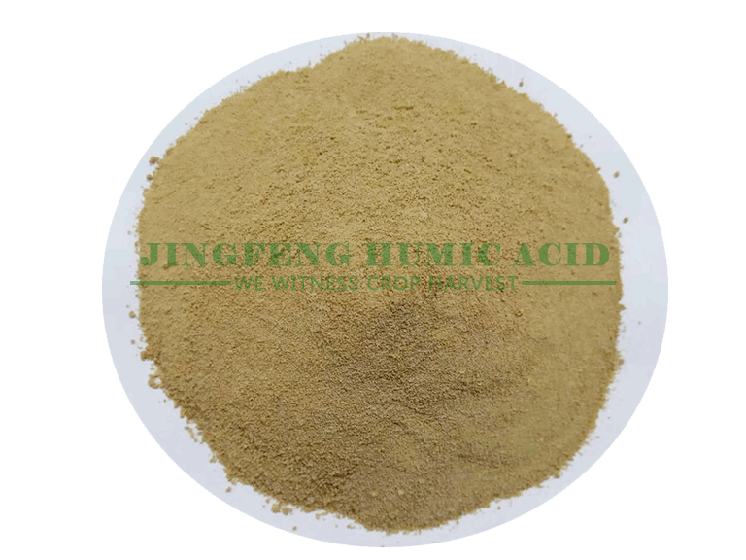
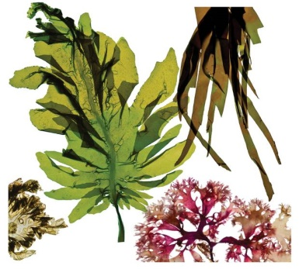
Seaweed Extract Flake / Powder
WE WITNESS CROP HARVEST AND HUMAN HEALTH
Seaweed Extract Flakes / Powder
Product Code | Appearance | Seaweed Polysaccharide | Alginic acid | K2O | Water Solubility | P2O5 | ph
JFHA-GSP | Green Powder | ≥50% | ≥40% | ≥20% | 100% | ≥2% | 6-7
JFHA-BSP | Brown Powder | ≥40% | ≥30% | ≥16% | 100% | ≥2% | 6-7
JFHA-SL | Green/Brown Liquid | / | / | / | 100% | / | 6-7
JFHA-BS-F/P | Black Flake/Powder | ≥35% | ≥20% | ≥20% | 100% | ≥2% | 9-10
Characteristic
Dosage
1. | 100% water solubility with no flocculation left
2. | Improve soil structure and utilization of potash
3. | Increase the release of potassium
4. | Increase the crop resistance of drought and disease
5. | Improve water storage capacity of soil
6. | Quick release organic fertilizer
7. | Enhance the usability of soil
8. | Stimulate crop growth, control the release of nutrients
9. | Improve the quality and yield of crops, promote the efficiency of fertilizer
1 | Dilute it with 3000-4000 times water, using for water flush irrigation, drip irrigation and foliar spray.
2 | Use it together with compound fertilizer in the percentage 1:100.
3 | Strengthen the effect of pesticide and foliar fertilizer: Add it together with pesticide or foliar fertilizer liquid in the percentage: 1:5000.
www.humicchina.com

Slide 16
45% Animal Source Amino Acid
WE WITNESS CROP HARVEST AND HUMAN HEALTH
1. Product Description
45% Animal source amino acid, which is fully called animal source compound amino acid powder, is formed from animal feather by acid hydrolysis. Such as duck feather, chicken feather, goose feather and so on, which can be absorbed by plants directly. It has the characteristics of both organic nitrogen and inorganic nitrogen. It is the main raw material of amino acid foliar fertilizer, and can also be directly used in crop flushing fertilizer, base fertilizer.
2. Main Specification
Service | Custom package, OEM product
Water solubility | Completely
Amino acid | 45% min
PH | 5.0-7.0
Organic Nitrogen | 8.2% min
Total Nitrogen | 17% min
5. Applicable Crops
All crops
6. Recommended Dosage
-Root irrigating with 500 times of water solution, Foliar spraying with 1000 times of water solution;
-Base fertilizer per 665㎡, 20-25KGS. Foliar fertilizer per 665㎡, 8-10KGS.
-Mixed with pesticides and has synergistic effect.
-Spraying effect is better before 10:00 a.m. or after 4 p.m.
-Respraying in the event of rain 2 hours after spraying
-In the growing season, the application is repeated according to the needs of agriculture and nutrition.
7. Packaging and storage
-20kgs/25kg woven/paper bags with inner liner.(The Most popular package)
-20kgs/25kg color printing PP/PE bags with inner liner.
-According to customers’ requirement.
3. Detail Introduction
Light yellow powder, good fluidity, 100% water solubility, dissolve instantly, and easy to absorb moisture. The content of the amino acid content at all levels is available , animal source 30%, 45%, plant source 30%, 40%, 45%, 50%, 70%, 80%.
4.Main function
The amino acid can promote the photosynthesis of the plant. It can increase the content of chlorophyll and make the photosynthesis more vigorous.
Good effects of a plurality of amino acid mixed nutrition. The fertilizer efficiency of the compound amino acid powder is higher than the single amino acid of the same amount of nitrogen, and is also higher than the inorganic nitrogen fertilizer of the equal amount of nitrogen.
Obvious effects can be observed in a short period of time after use. At the same time, it can promote the early maturity of crops and shorten the growth cycle.
Improve crop quality. Enriched amino acids can improve the quality of crops. For example, the protein content of grain increased by 3%, cotton flower velvet quality was good, longer fiber; vegetable palatability was good, crude fiber decreased; flower flowering period was long, flower color was bright, aroma was strong, melon and fruit sugar content increased, edible part was more, storage resistance was good.
Clean and pollution-free, improve the ecological environment. The fertilizer applied in the field has no residue, which can improve the physical and chemical properties of soil, improve the fertility and water conservation and air permeability, and play the role of conservation, ripening and soil improvement.
The metabolic function enhanced and the ability of resistance improved. After amino acids are absorbed by crops, their physiological and biochemical functions can be strengthened. Crops can mature early, but also due to their own vitality enhancement, cold and drought resistance, resistance to dry and hot wind, resistance to diseases and insect pests and lodging resistance improved, so as to achieve stable yield and high yield.
The root system developed and the absorption ability enhanced. Amino acids play a special role in promoting the root development of crops, which leads to the rapid root development, the increase of secondary roots, the increase of root quantity and the extension of roots, which leads to the great enhancement of the ability of crops to absorb water and nutrients.

Slide 17
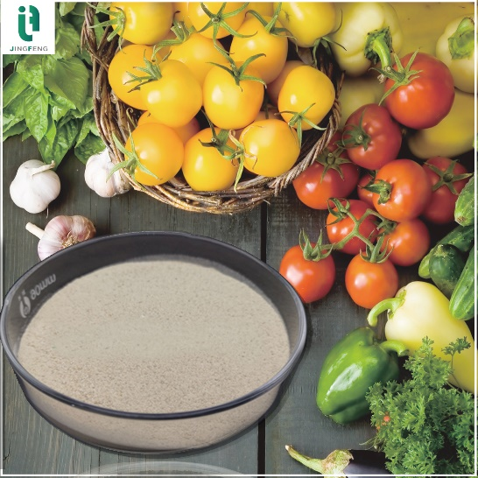
80% Plant source amino acid
WE WITNESS CROP HARVEST AND HUMAN HEALTH
1.Product Description
The raw materials for the production of 80% plant source amino acids are soybean or soybean meal. Rich in amino acids, nitrogen and organic matter, used as fertilizer directly, can be flushed, sprayed, the effect is remarkable. Fully soluble in water, suitable for drip irrigation, flushing, Foliar spraying, etc., wide range of application, can promote balanced growth of plants, balanced nutrition, improve yield, enhance quality. At the same time, the product is widely used in aquaculture and feed additive industry because of its rich content of many elements, easy to be absorbed by organisms, and after spray drying, the physical and chemical properties of large volume and light weight, widely used in aquaculture and feed additive industry.
2.Mean Specifications
Total Amino Acid | 80% min
Moisture | 5% max
Amino Nitrogen | 12% min
Ph | 5-7
Water Solubility | 100%
3.Fertilizer application
a) Main function
Chelate soil nutrients, stimulate root growth, make crops stable, strong, high fertilizer utilization and significant yield.
Improve the photosynthetic performance of crops, promote the transfer and transport of photosynthetic products, improve crop quality, promote their commodity performance.
The microenvironment of crop rhizosphere was improved, the occurrence of soil-borne diseases was restrained, and the effect of resistance to continuous cropping was obvious.
Combined application with inorganic fertilizer can increase the synergistic effect of nutrients, and the effect of crop yield increase is very significant.
Long-term application, make the soil porous and loose, reduce the hardening degree of the soil, improve the soil conservation and the water retention capacity of the soil.
This series of products is the ecological organic fertilizer that must be used in organic food base, green food base and pollution-free food base.
b) Range of application
Widely used in fruit trees, vegetables, garden flowers, Chinese medicinal materials and greenhouse crops. Especially suitable for pollution-free, green product production.
c) Dosage and application
Recommended dosage: base fertilizer, flushing 20-40kg/665㎡, spraying 1-3kg /665㎡
Mixed with pesticides, mutual effect.
Spraying effect is better before 10:00 a.m or after 4:00 p.m.
Re-spray in case of rain within 2 hours after spraying
Repeated application according to agricultural and nutritional needs during the growing season.
d)Packaging and storage
20kg/bag, 10kg/bag
Keep airtight and in a dry and ventilated place
4.The main effect of being used as animal feed
Increase fragrance and fresh, promote animal appetite. This product has the effect of enriching sauce flavor and fragrant on feed. The glutamic acid content of this product is nearly 5%. It has the effect of adjusting feed taste and promoting animal appetite.
Rapid replenishment of animal nutrition and enhancement of feed utilization rate.
Promote the growth of animal fur. This product is keratin hydrolysate, rich in cystine, tyrosine, serine and other amino acids conducive to the growth of animal fur. After eating, animals have ruddy skin and bright hair.
It has certain adhesion ability and can enhance the setting of granule feed.
5.The main effect in aquatic products
a)Main function
The effect of super energy of water fertilizer, especially low temperature, cloudy rain and no sunshine weather, is obviously better than that of other products.
Amino acids is very suitable for the culture of plankton and beneficial algae, and are more helpful for black aquatic young animals to provide stage palatable active food and promote rapid production and development.
Less dosage, no environmental pollution, no hardening of the bottom of the tank, completely water soluble, improved culture environment, environmental protection and high efficiency,
Improve disease resistance, insect pests resistance immunity, reduce mortality, promote rapid growth and development, improve yield and quality
b)Dosage
Spilt the whole tank after being dissolved with water, and 0.5kg-0.8kg of the product is used for each 665㎡of 1-meter deep water tank.
6.Note:
This product absorbs moisture and agglomerate, which is a normal phenomenon and should be stored in a cool and dry place.

Slide 18
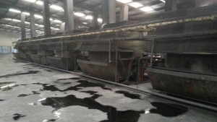
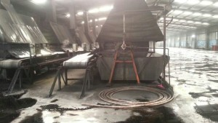
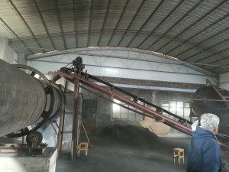
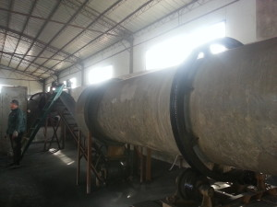
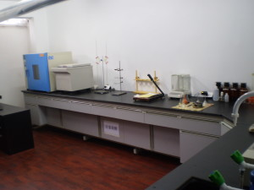
Company Show
WE WITNESS CROP HARVEST AND HUMAN HEALTH
Company
Show
文字
文字
文字
文字
文字
文字
防尘
www.humicchina.com

Slide 19
Quality Control
WE WITNESS CROP HARVEST AND HUMAN HEALTH
Humic & Fulvic content
Sampling
Inspection
Raw
Material
Inspection
During Producing
Leonardite
Lignite
Humate
Fulvate
Fulvic acid
Raw Material
Final Products
www.humicchina.com

Slide 20
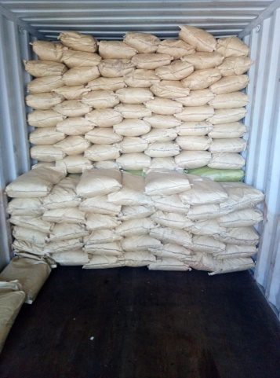
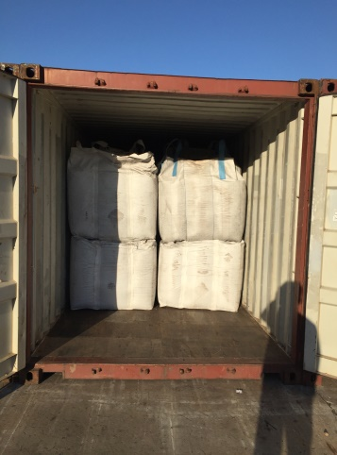
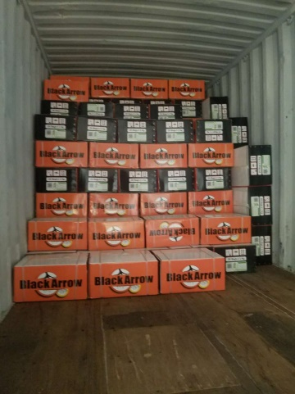
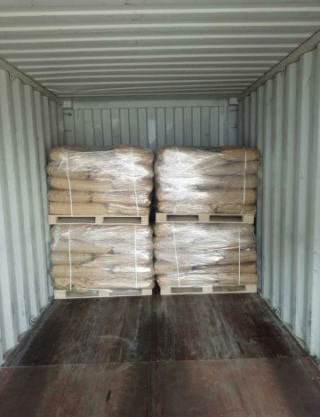
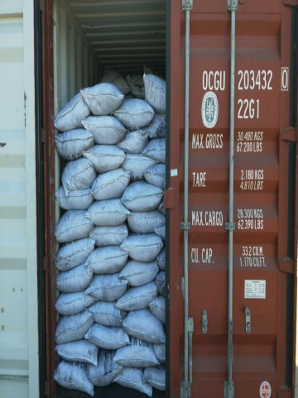
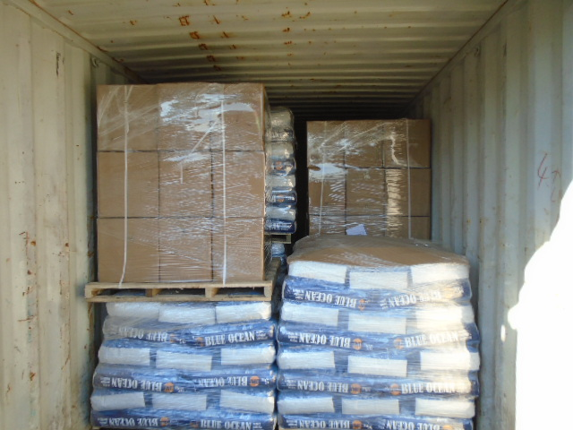
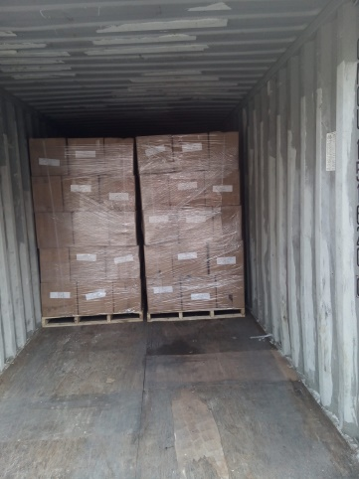
Final Product Condition
WE WITNESS CROP HARVEST AND HUMAN HEALTH
According to customers’ demand
25kg woven bags with inner liner. | Color printing PP bags with inner liner or PE bags.
1MT,1.1MT jumbo bags with discharge hole. | According to customers’ requirement.
www.humicchina.com

Slide 21
Sales Performance
2015
2016
2017
www.humicchina.com

Slide 22
COMPANY：Jingfeng Humic Acid
DATE: 2017-12-20
COOPERATION REALIZE DREAMS
www.humicchina.com

